Slide 1
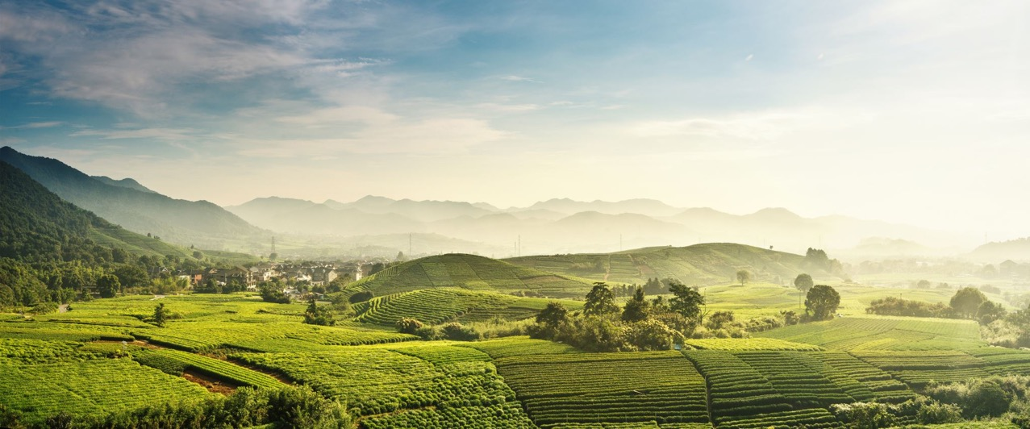

Foundations of Plant Pathology
Created by: Nicole Colón-Carrión
Revised by: Sofía Macchiavelli-Girón

Slide 2
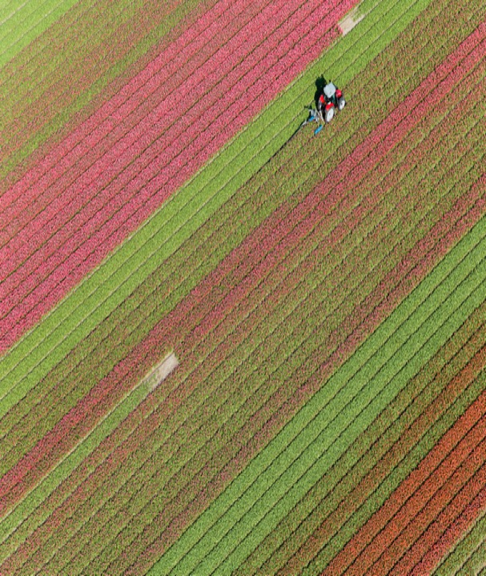

From the Classroom to the Farm
Session 1. Introduction to Plant Pathology
Time: 40 minutes
Session 2. Signs and Symptoms of Plant Disease
Time: 1 hour
Session 3. Factors Causing Disease in Plants
Time: 1 hour

Slide 3

From the Classroom to the Farm
Learning Goals
1. Introduce the field of plant pathology
2. Distinguish between signs and symptoms
3. Learn about agents of disease in plants

Slide 4

Introduction to Plant Pathology
Session 1

Slide 5
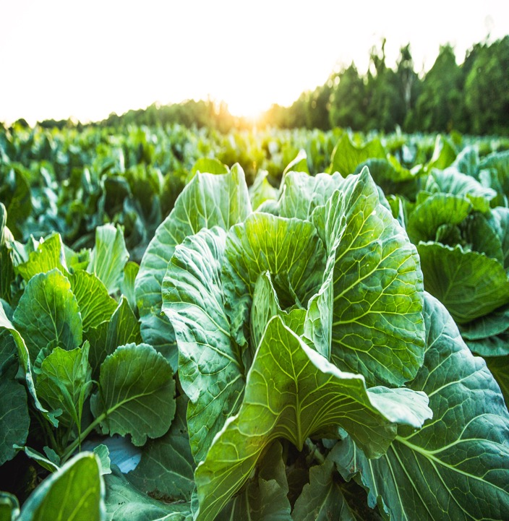
From the Classroom to the Farm
Plant Pathology
Plant pathology is the science that studies plant diseases
It attempts to improve the chances of plant survival
Focus on:
Finding the cause
Describing the mechanism
Looking for solutions

Slide 6

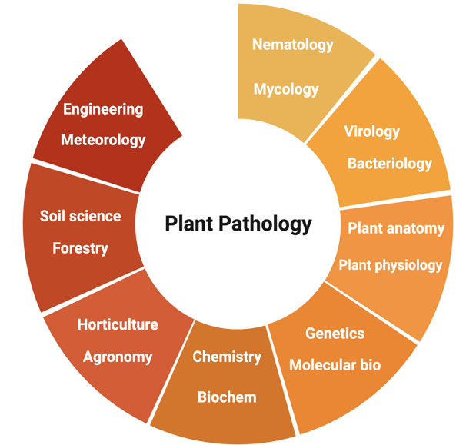
From the Classroom to the Farm
Plant Pathology
Plant pathology is an integrative or multidisciplinary science
Created in Biorender.com

Slide 7

From the Classroom to the Farm
Goals of Plant Pathology
1. Increase knowledge about plant diseases
2. Develop methods, equipment, and material for management and control
3. Protect food and resources for generations to come

Slide 8
From the Classroom to the Farm
Importance of Plant Pathology
1. Protects crops against disease and disease epidemics
2. Allows for the maintenance of food security
3. Provide farmers the necessary information and aids to protect their crop and their source of income

Slide 9

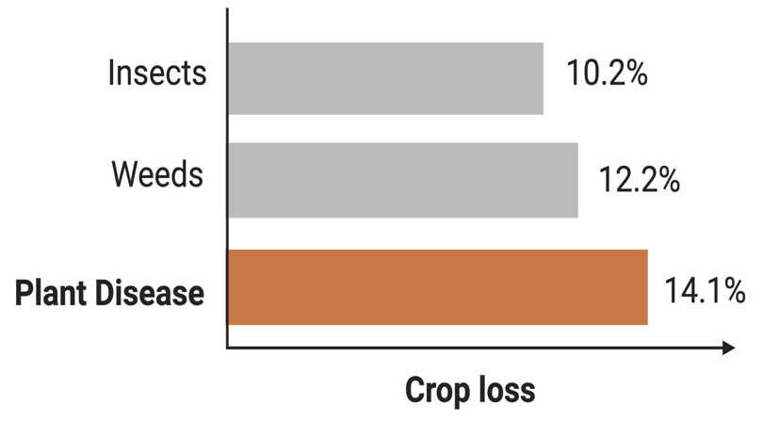
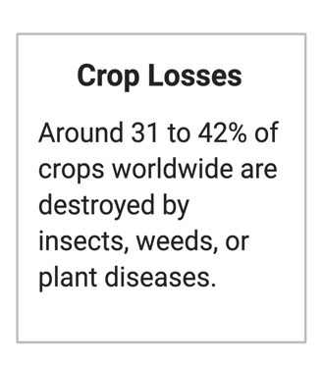
From the Classroom to the Farm
Plant Disease & Crop Production
Created in Biorender.com

Slide 10
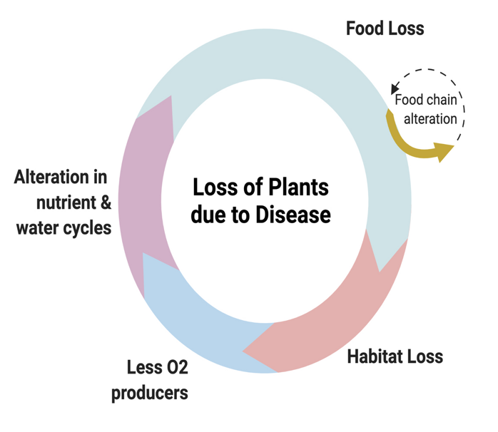
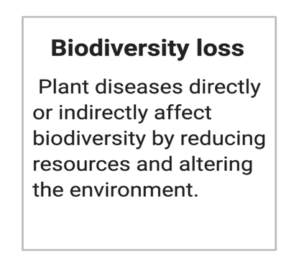
From the Classroom to the Farm
Plant Disease & Biodiversity
Created in Biorender.com

Slide 11
From the Classroom to the Farm
Challenges of Plant Pathology
1. Reduce food loss while improving its quality
2. Produce enough food while protecting the environment and reducing land loss
3. Re-emergence of pathogens and pests due to climate change

Slide 12
From the Classroom to the Farm
Disease Triangle
Shows the interactions between the environment, the host, and a pathogen
Published by Stevens in 1960
Created in Biorender.com

Slide 13
From the Classroom to the Farm
Limitations
1. Disease occurs over time
2. Some diseases are transmitted by vectors
3. Human activity can lead to disease

Slide 14
From the Classroom to the Farm
Koch’s Postulates
Set of criteria designed to determine a causative relationship between a microbe and a disease
Published by Robert Koch in 1890
Created in Biorender.com

Slide 15
From the Classroom to the Farm
Exceptions
1. Not all microbes can be grown in pure culture
2. Some diseases are caused by more than
one microorganism
3. Not all diseases are symptomatic
4. Infection with the same microorganism
may lead to different diseases

Slide 16
Signs and Symptoms of Plant Diseases
Session 2

Slide 17
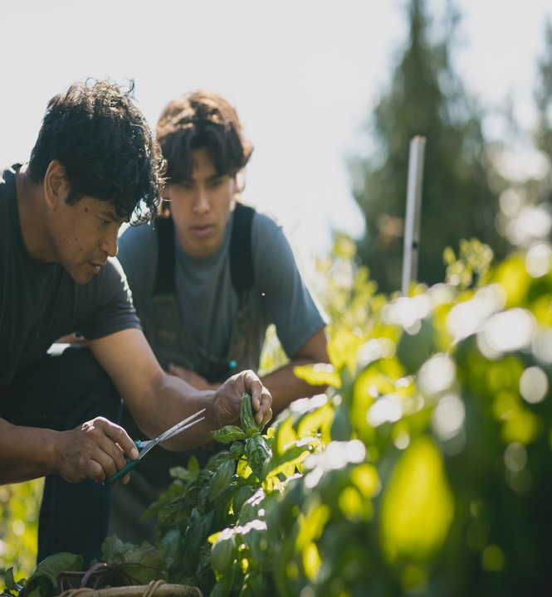
From the Classroom to the Farm
Plant Disease
A disease is any malfunctioning of host cells and tissues
A plant disease is any abnormal condition that alters the appearance or function of a plant
Invisible or visible responses of the plant to an agent of disease
Can cause impairment or death of the plant

Slide 18
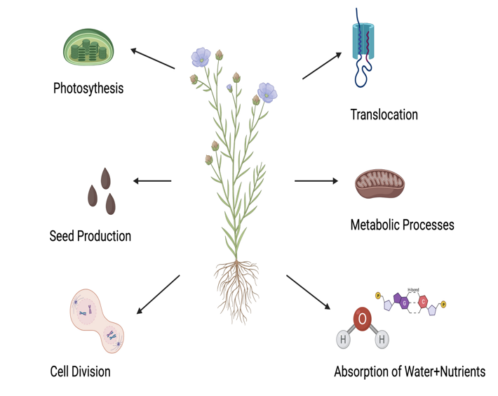
From the Classroom to the Farm
Plant Functions
Created in Biorender.com

Slide 19
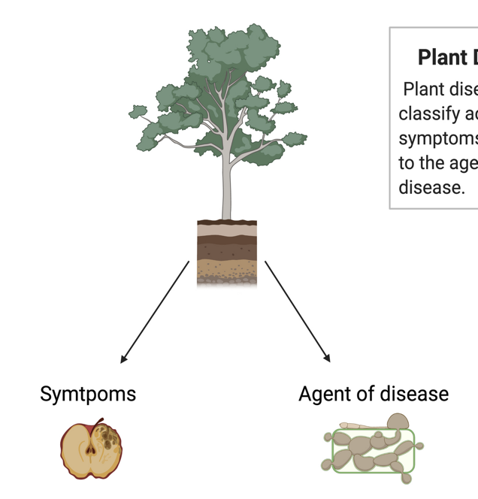
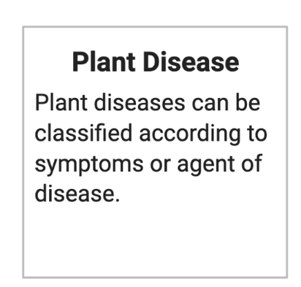
From the Classroom to the Farm
Created in Biorender.com

Slide 20
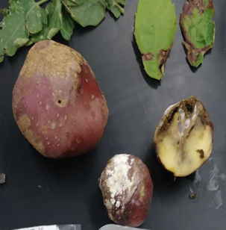
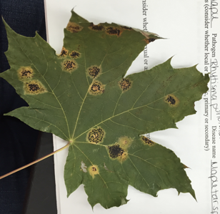
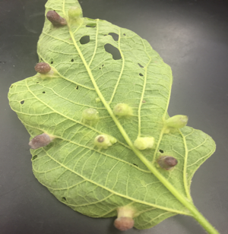
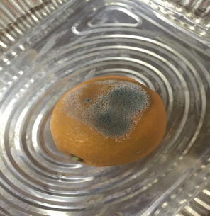
From the Classroom to the Farm
Signs
A sign is the physical evidence of the pathogen in the plant
Example =
Fungal spores
Bacterial ooze
Bacterial streaming

Slide 21
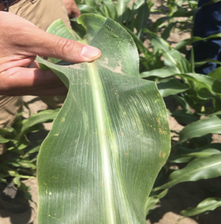
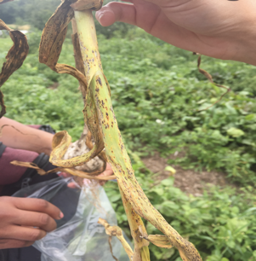
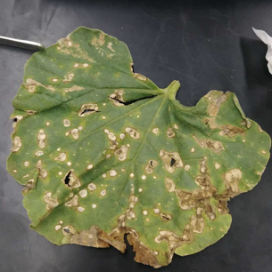
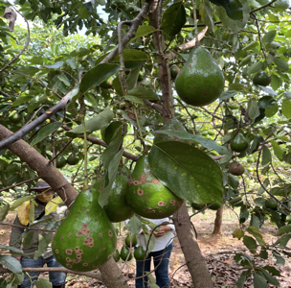
From the Classroom to the Farm
Symptoms
A symptom is a visible change in the plant
Can be changes in color, shape, or functions
Example =
Leaf wilting
Chlorosis
Crown galls

Slide 22

From the Classroom to the Farm
Importance of Signs and Symptoms in Disease Diagnosis
1. Identifying symptoms and signs of plant disease are one of the 1st steps in disease diagnosis
2. Allows plant pathologists to narrow the possibilities
3. The use of symptoms and signs alone is an inadequate method for disease diagnosis
4. Signs are usually more helpful when determining the causal agent
5. A combination of field survey, laboratory testing, and farmer's perspective is essential for diagnosis

Slide 23
Factors Causing Disease in Plants
Session 3

Slide 24
From the Classroom to the Farm
Created in Biorender.com

Slide 25
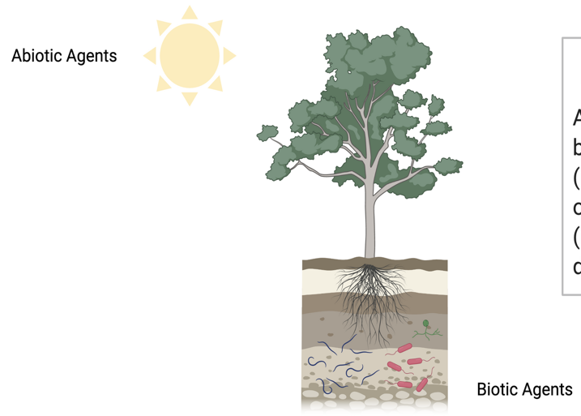
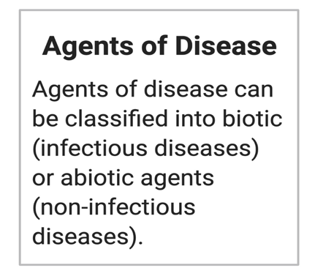
From the Classroom to the Farm
Created in Biorender.com

Slide 26

From the Classroom to the Farm
Non-infectious Diseases
Non-﻿infectious diseases are those caused by abiotic agents
For example:
Lack of nutrients
Lack of moisture
Lack of oxygen
High temperatures
Chemical toxicity

Slide 27
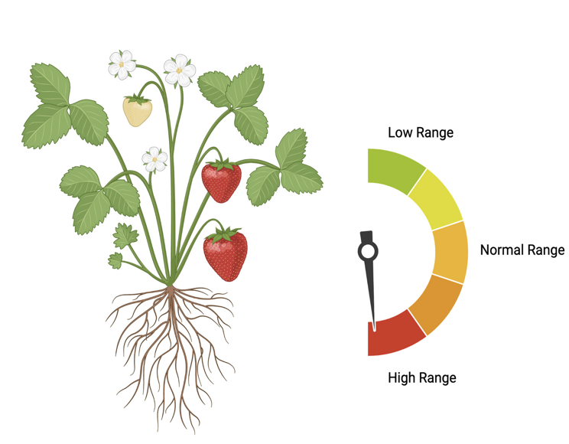
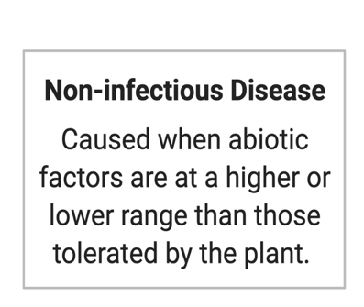
From the Classroom to the Farm
Created in Biorender.com

Slide 28
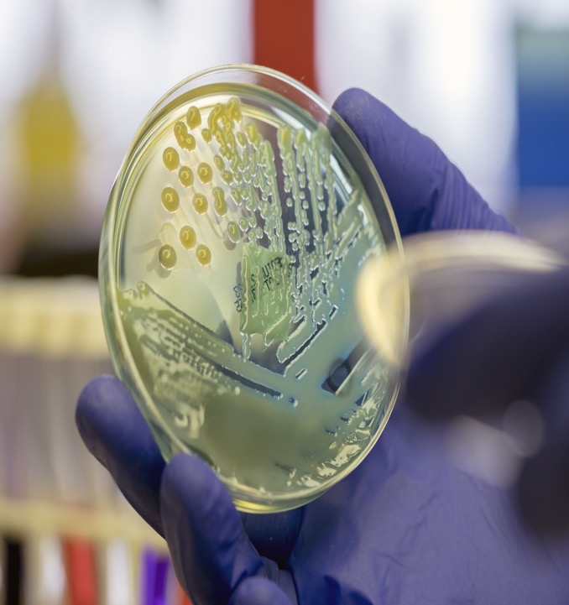
From the Classroom to the Farm
Infectious Diseases
Infectious diseases are those caused from the infection of a plant pathogen (biotic agent)
Types of Pathogen
Fungi
Bacteria
Virus
Viroids
Protozoa

Slide 29
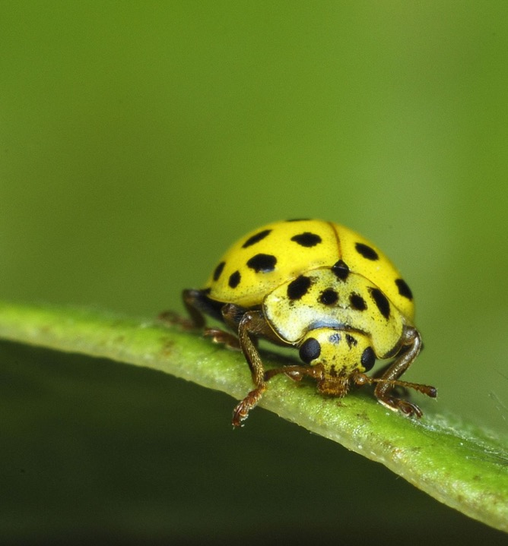
From the Classroom to the Farm
Plant pathogens vs. pests
Plant pathogens are usually defined as microscopic organisms that cause diseases in plants
Animal pests are usually defined as organisms (nematodes, whiteflies, etc.) that feed on or damage plants
Although plant pathologists work on the management and control of both groups of organisms, they mainly focus on the study of plant pathogens

Slide 30
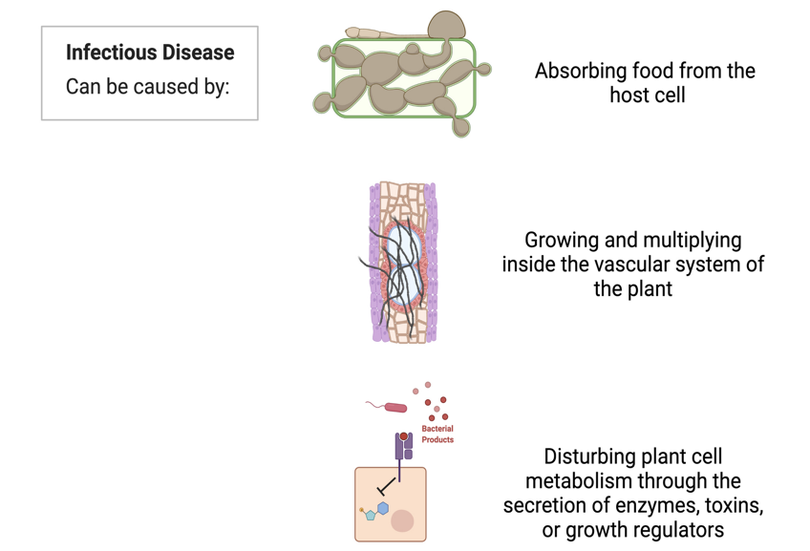
From the Classroom to the Farm
Created in Biorender.com

Slide 31
From the Classroom to the Farm
Infectious Diseases
Some pathogens are restricted to a single plant species
Others have a wide range of host plants
These pathogens can invade, feed, and grow inside the host
They can be spread and cause disease in healthy plants

Slide 32
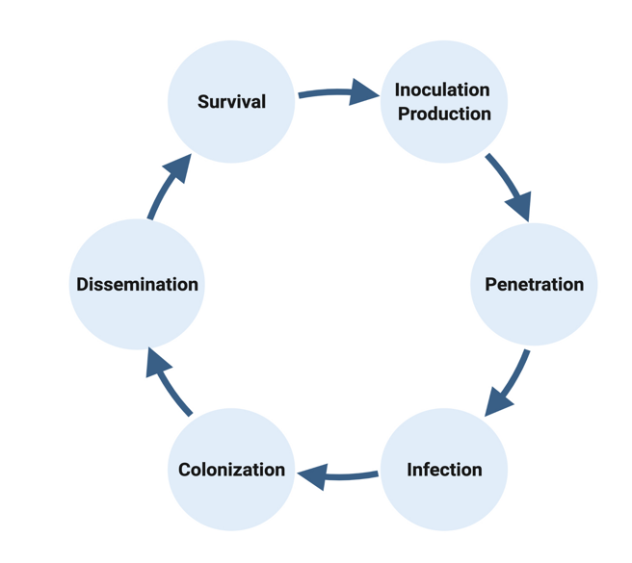
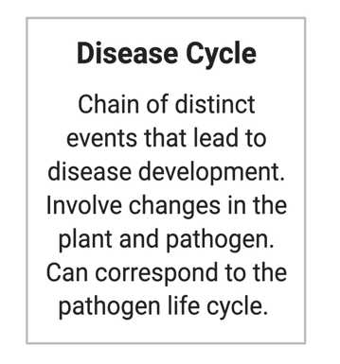
From the Classroom to the Farm
Created in Biorender.com

Slide 33
From the Classroom to the Farm
Inoculum Production
Inoculum is any part of the pathogen that can initiate infection
First step of disease development
Examples:
Fungi: spores, sclerotia, mycelium
Bacteria: whole individual
Virus: whole individual
Nematodes: adult, juveniles, eggs

Slide 34
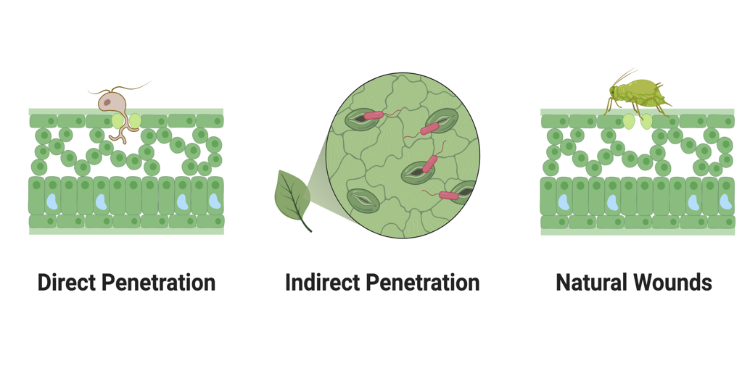
Types of Penetration
From the Classroom to the Farm
Created in Biorender.com

Slide 35
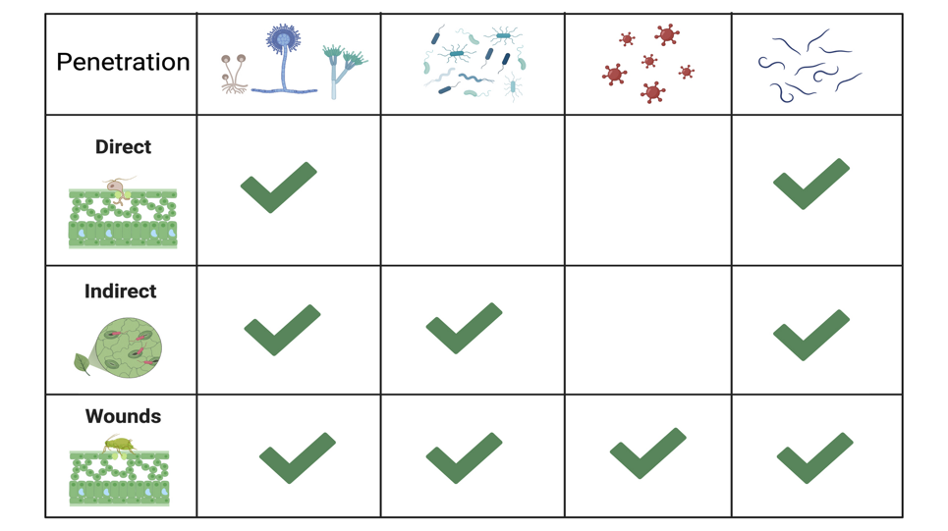
Types of Penetration
From the Classroom to the Farm
Created in Biorender.com

Slide 36
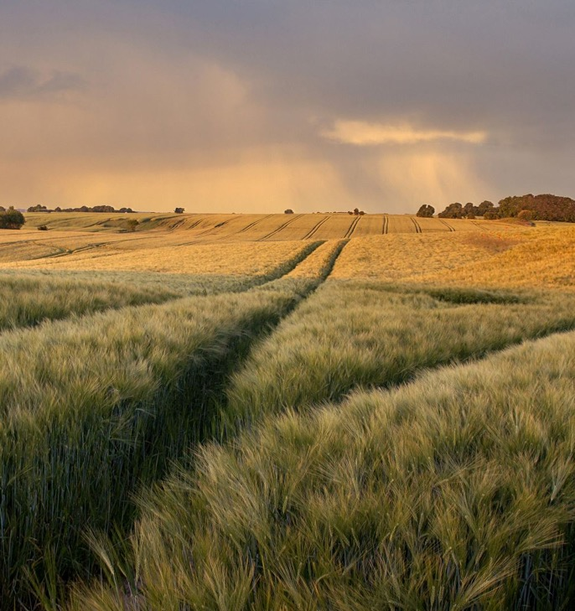
From the Classroom to the Farm
Dissemination
The movement of the inoculum from one host to another is referred to as dissemination
This step is essential to continue the pathogen's life
Two types:
Active
Passive

Slide 37
From the Classroom to the Farm
Passive Dissemination
Active Dissemination
Passive dissemination is a movement of the inoculum through external agents
External agents:
Wind
Water
Vectors
Agricultural practices: transplantation or propagation of infected material, infected equipment
Active dissemination occurs through the own movement of the pathogen or the source they belong
No external agents are involved
Example:
Nematode movement through soil
Root-to-root contact of plants
Chemical signaling

Slide 38
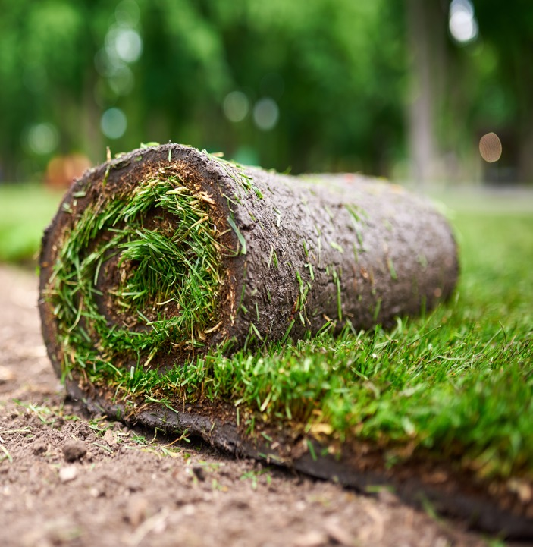
From the Classroom to the Farm
Survival
Many pathogens can survive without the need of an active metabolic host
Sources of survival:
Plant debris
Soil
Propagative material
Insects
Weeds or non-hosts
Some pathogens produce specialized structures that allow them to survive (sclerotia, chlamydospores)

Slide 39
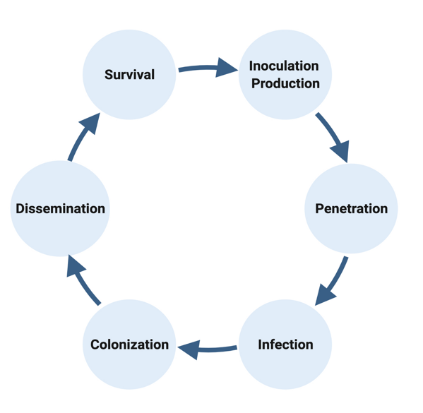
From the Classroom to the Farm
Importance of Disease Cycle
Knowledge of these mechanisms is essential for the effective control of plant diseases
It allows scientists to manage and control these diseases

Slide 40
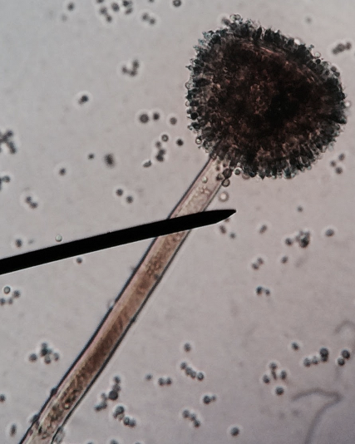
From the Classroom to the Farm
Fungi
Eukaryotic organisms belonging to the Fungi Kingdom
Cosmopolitan and mostly terrestrial
More than 10,000 species are known to cause diseases in plants

Slide 41
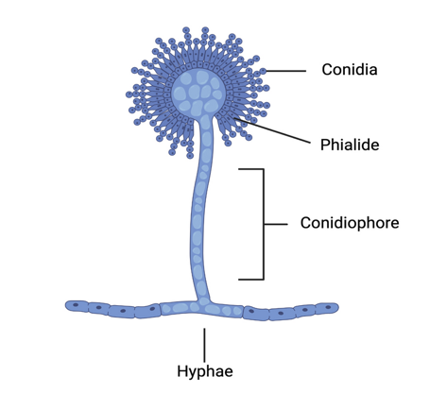
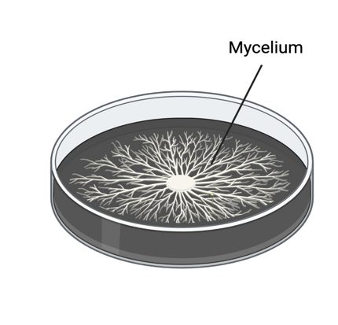
Morphology
From the Classroom to the Farm
Created in Biorender.com

Slide 42
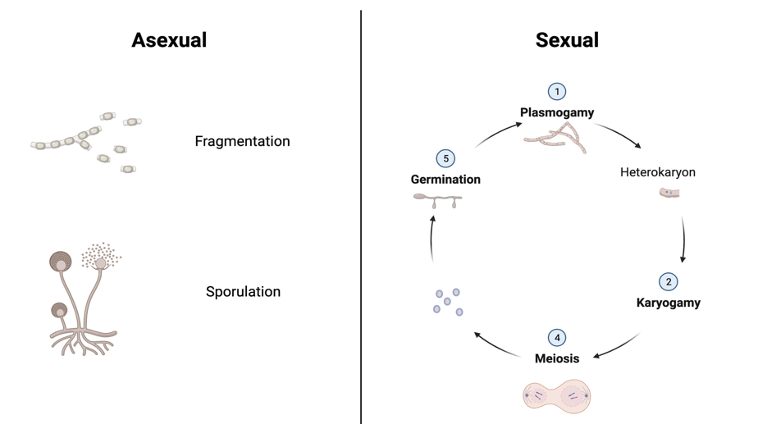
Reproduction
From the Classroom to the Farm
Created in Biorender.com

Slide 43
From the Classroom to the Farm
Survival, Dissemination, & ID
Survival depends on the environmental conditions such as temperature or moisture
Dissemination is primarily passive using external agents such as water, air, and movement of contaminated equipment
Identification is based on the combination of morphological characteristics (spore shape, size, etc.) and molecular testing

Slide 44
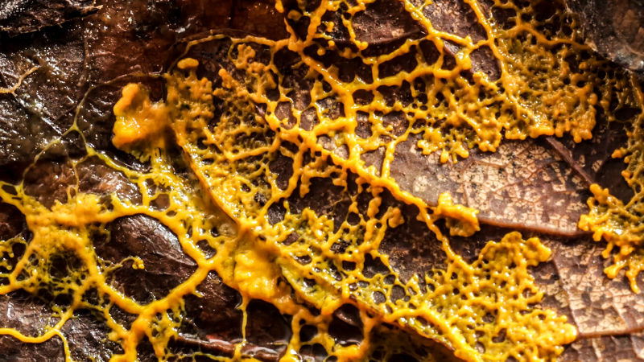
From the Classroom to the Farm
Fungi-like organisms
Organisms that do not belong to the Fungi Kingdom but share common characteristics
They are often misclassified as fungi
Include slime molds, water molds, etc.

Slide 45
From the Classroom to the Farm
Myxomycetes
Oomycetes
Slime molds belonging to the Protozoa
Body is a plasmodium and produces zoospores
Cause disease by growing externally on the surface of plants
Common in warm weather after heavy rain
Fungi-like eukaryotes
Mycelium composed of cellulose
Reproduce sexually and asexually
Produce zoospores and oospores
Worst plant pathogens: Pythium and Phytophthora

Slide 46
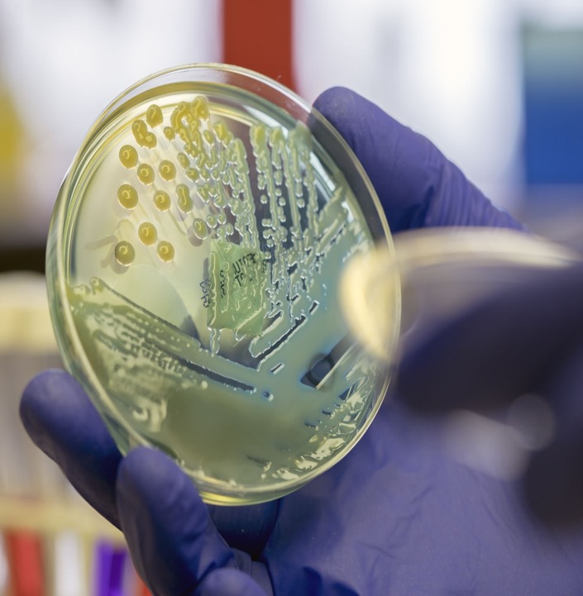
From the Classroom to the Farm
Bacteria
Prokaryotic organisms
Largest group of plant pathogenic prokaryotes
About 100 species are known to cause disease in plants

Slide 47
From the Classroom to the Farm
Template from Biorender.com

Slide 48
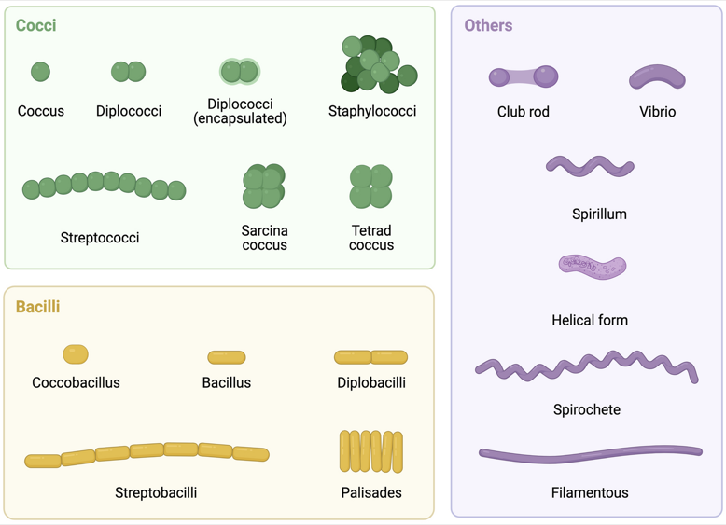
Morphology
From the Classroom to the Farm
Created in Biorender.com

Slide 49
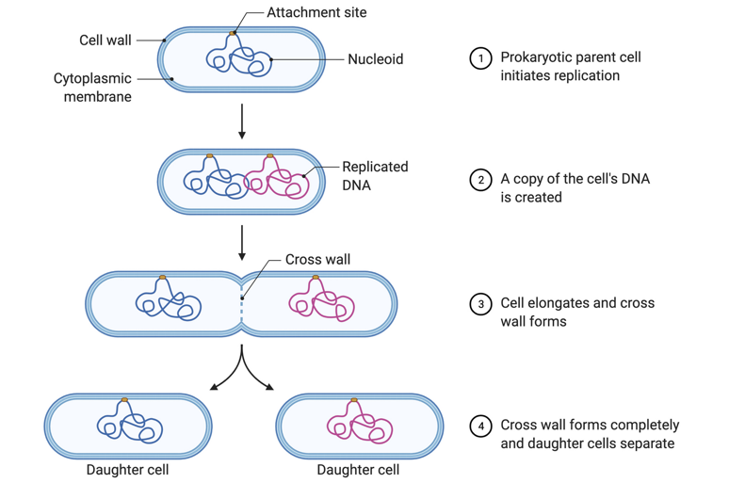
Reproduction
From the Classroom to the Farm
Template from Biorender.com

Slide 50
From the Classroom to the Farm
Survival, Dissemination, & ID
Can survive on seeds, parts of the plant, or soil, but survival depends on the environmental conditions
Dissemination is mostly passive using external agents such as water, insects, and movement of contaminated equipment
Identification is based on the combination of morphological characteristics, molecular testing, chemical composition, serological reactions, and enzymatic activity

Slide 51
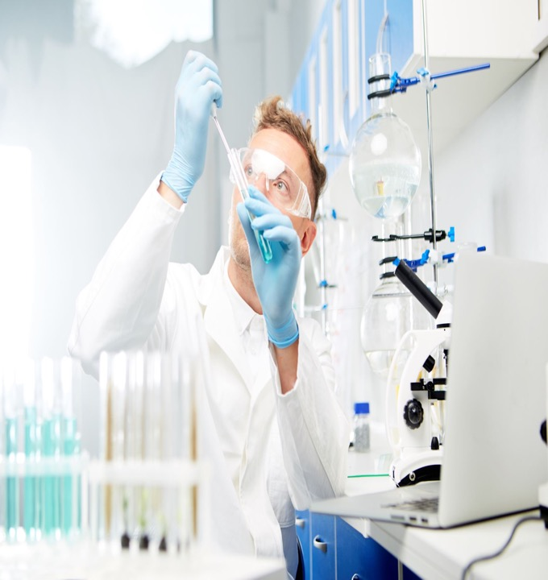
From the Classroom to the Farm
Virus
Nucleoprotein that multiplies only in living cells
Can only be seen with specialized microscopes
Composed of RNA or DNA

Slide 52
From the Classroom to the Farm
Template from Biorender.com

Slide 53
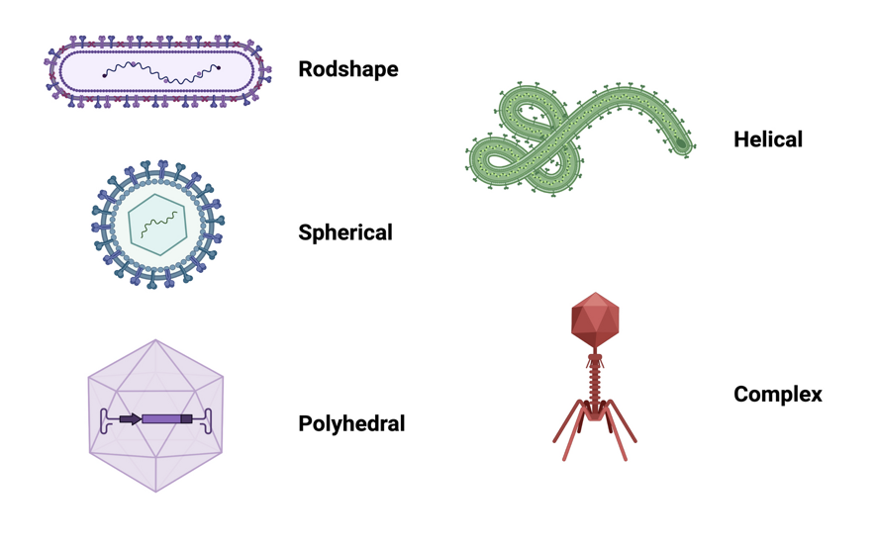
Morphology
From the Classroom to the Farm
Created in Biorender.com

Slide 54
Reproduction
From the Classroom to the Farm
Created in Biorender.com

Slide 55
From the Classroom to the Farm
Survival, Dissemination, & ID
Dissemination is mainly using a vector
Few require long-term survival in the environment
Identification is based on determining the properties of the virus through pathogenicity tests, transmission assays, morphological characteristics, and immunological and nucleic acid procedures

Slide 56
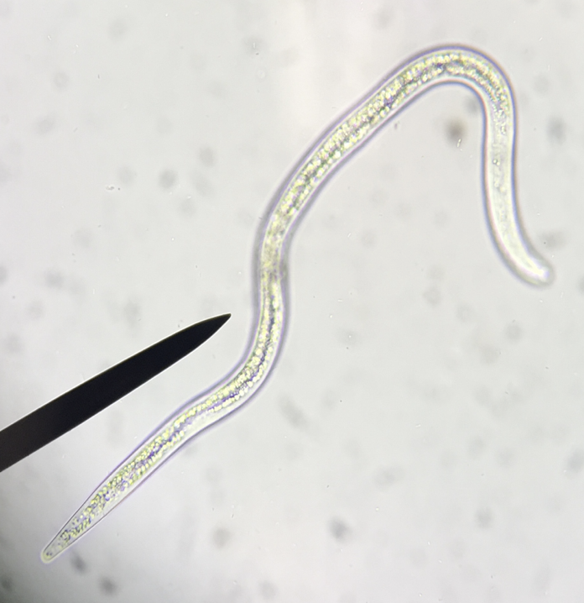
From the Classroom to the Farm
Nematodes
Eukaryotic organisms belonging to the Kingdom Animalia
More than ~100 species are known to feed on plants
Invisible for the naked eye

Slide 57
From the Classroom to the Farm
Nematodes
300 to 1,000 micrometers long
15-35 micrometers wide
Sexual or parthenogenetically through eggs

Slide 58
From the Classroom to the Farm
Survival, Dissemination, & ID
Dissemination through the soil, but they move a few centimeters in one season by their power
Disseminated faster through water or movement of soil
Survival is affected by soil temperature, moisture, and aeration

Slide 59
References
From the Classroom to the Farm
Agrios, G. (2005). Plant Pathology. 5th edition. Editorial Elsevier Academic Press.
Burchett & Burchett (2018). Plant Pathology. 1st edition. Garland Science.
Schumann & D’Arcy (2009). Essential Plant Pathology. 2nd edition. American Phytopathological Society.
Singh (2017). Introduction to Principles of Plant Pathology. 5th edition. Medtech.
Graphic: BioRender.com

Slide 60
Glossary
From the Classroom to the Farm
Multidisciplinary: involving two or more subject areas
Vector: living organism that carries and transmit a pathogen
Disease: any harmful deviation from the normal structural or functional state of an organism
Dormancy: state of reduced metabolic activity adopted by many organisms under conditions of environmental stress
Translocation: when a chromosome break occurs in each of two nonhomologous chromosomes and the two breaks rejoin in a new arrangement
Photosynthesis: the process by which green plants and certain other organisms transform light energy into chemical energy
Cell division: the process by which cells reproduce
Spore: a reproductive cell
Bacterial "ooze”: exudate seen coming out of water-soaked lesions
Bacterial streaming: is a leaking of bacteria out of plant tissue
References: https://www.britannica.com/ & https://www.wikipedia.org/

Slide 61
Glossary
From the Classroom to the Farm
11. Chlorosis: is a yellowing of normally green leaves due to a lack of chlorophyll
12. Wilting: is the loss of rigidity of non-woody parts of plants
13. Necrosis: death of a circumscribed area of plant tissue as a result of disease or injury
14. Eukaryote: cell that possesses a clearly defined nucleus
15. Prokaryote: cell that lacks a distinct nucleus and other organelles due to the absence of internal membranes
16. RNA (ribonucleic acid): complex compound of high molecular weight that functions in cellular protein synthesis
17. DNA (deoxyribonucleic acid): codes genetic information for the ttransmission of inherited traits
References: https://www.britannica.com/ & https://www.wikipedia.org/

